Slide 1
TEEN: A Routing Protocol for Enhanced Efficiency
Wireless Sensor Networks
Yash Nag
15UCS173

Slide 2
What the paper is about
In this paper (and presentation) we are providing literature review and a separate implementation of TEEN (Threshold sensitive Energy Efﬁcient sensor Network protocol) Energy Efficient Protocol for reactive networks. We evaluate the performance of our protocol for a simple temperature sensing application.
In terms of energy efﬁciency, TEEN protocol has been observed to outperform existing conventional sensor network protocols.

Slide 3
Classification Of Sensor Networks
Proactive Networks - The nodes in this network periodically switch on their
sensors and transmitters, sense the environment and transmit the data of interest.
Reactive Networks - In this scheme the nodes react immediately to sudden
and drastic changes in the value of a sensed attribute.

Slide 4
Sensor Network Model
We now consider a model which is well suited for these sensor networks. It consists of a base station(BS), away from the nodes, through which the end user can access data from the sensor network. All the nodes in the network are homogeneous and begin with the same initial energy. The BS however has a constant power supply and so, has no energy constraints. It can transmit with high power to all the nodes. Thus, there is no need for routing from the BS to any specific node .

Slide 5
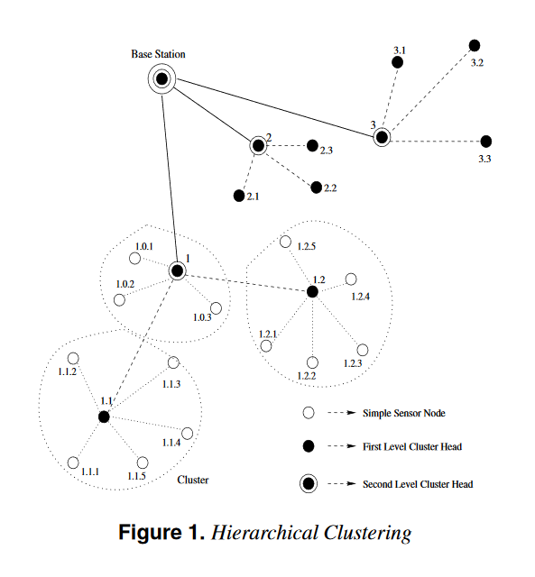
The main feature of such an architecture are:
All the nodes need to transmit only to their immediate cluster-head, thus saving energy.
Only the cluster head needs to perform additional computations on the data. So, energy is again conserved.
Cluster-heads at increasing levels in the hierarchy need to transmit data over correspondingly larger distances. Combined with the extra computations they perform, they end up consuming energy faster than the other nodes.

Slide 6
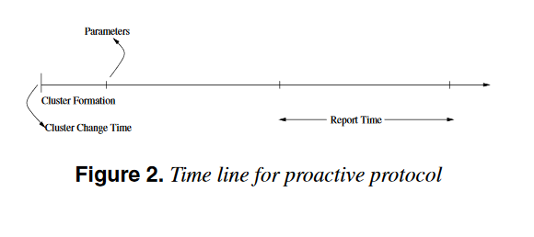
Proactive Network Protocol
At each cluster change time, once the cluster-heads are decided, the cluster-head broadcasts the following parameters :
Report Time(TR) : This is the time period between successive reports sent by a node.
Attributes(A) : This is a set of physical parameters which the user is interested in obtaining data about.

Slide 7
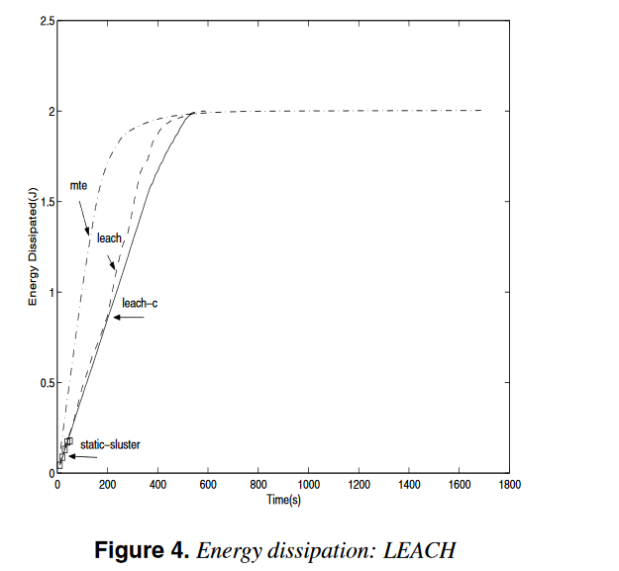
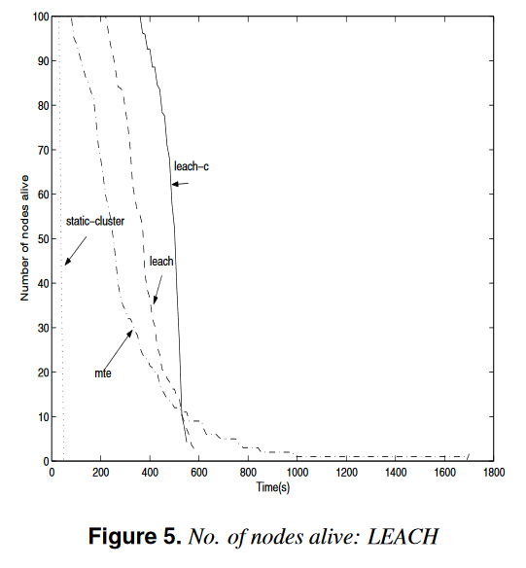
Leach and leach-c (a variant of leach ) can be considered the most efficient protocols, in terms of both energy dissipation and longevity.

Slide 8
Reactive Network Protocol: TEEN
TEEN (Threshold sensitive Energy Efficient sensor Network protocol)
Hard Threshold (HT): This is a threshold value for the sensed attribute. It is the absolute value of the attribute beyond which, the node sensing this value must switch on its transmitter and report to its cluster head.
Soft Threshold (ST): This is a small change in the value of the sensed attribute which triggers the node to switch on its transmitter and transmit.

Slide 9
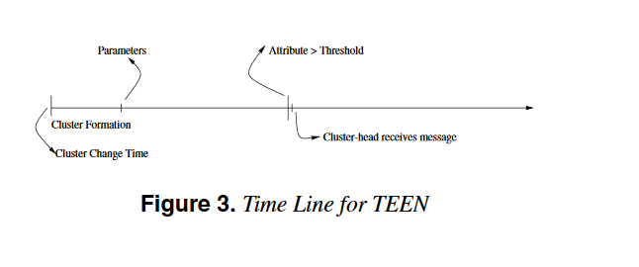
The nodes sense their environment continuously. The sensed value is stored in an internal variable in the node, called the sensed value (SV).
The nodes will next transmit data in the current cluster period, only when both the following conditions are true:
1. The current value of the sensed attribute is greater than the hard threshold.
2. The current value of the sensed attribute differs from SV by an amount equal to or greater than the soft threshold.

Slide 10
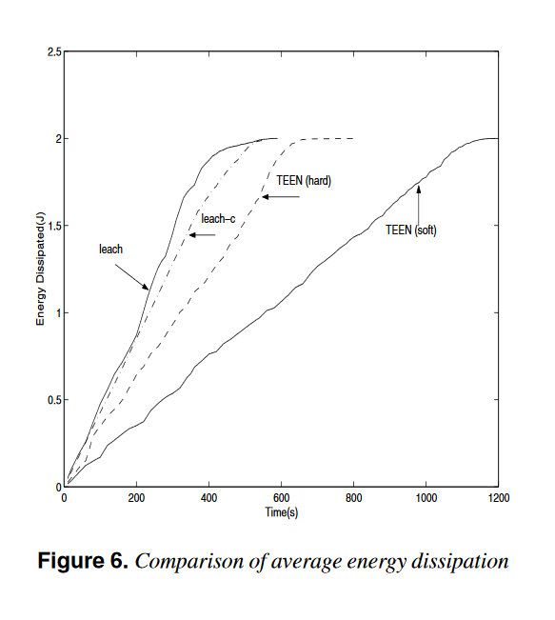
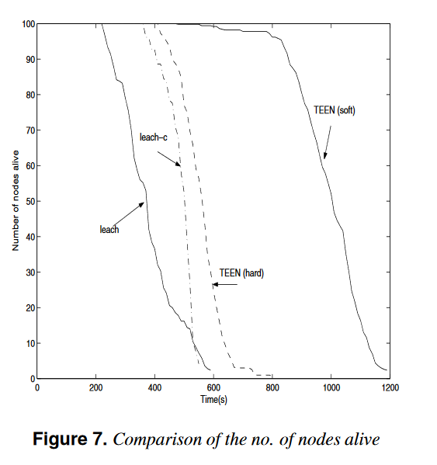
RESULTS

Slide 11
Thank You

